Slide 1
GUI
Technology Review
Mason Keller, Logan Sayyadi, Henry Nguyen

Slide 2
What we want in UI design
Ease of use: How quickly can it be learned? Is deep framework knowledge required for simple task?
Want: Easy to learn, able to work with minimal knowledge of GUI framework.
Lines of Code: How many lines of code are required to render a component?
Want: Simple. Minimal lines of code per component.
Integration: How easy is it to plug into our existing code?
Want: Easy, plug and play with the analysis tools we’ve built.
Data Display: Is there built-in support for figures relevant to Gage R&R?
Want: Supports figures generated using altair and has ability to display tables.
Deployment: Do you need to install it or is it web based? Can anyone reasonably run it?
Want: Web-based. No technical knowledge required for users to install & run app.

Slide 3

PyQt6
Pros:
Professional and customizable
Runs fully offline with no server or browser
Well documented with lots of Stack Overflow answers
Allows for multi-window applications
Great for visualizing data: Can add spreadsheet tables and embed plots for easy use
Cons:
Steep Learning Curve
A lot of repetitive code for simple features
May be tedious to integrate with existing code
Not designed with pandas/numpy workflow in mind

Slide 4
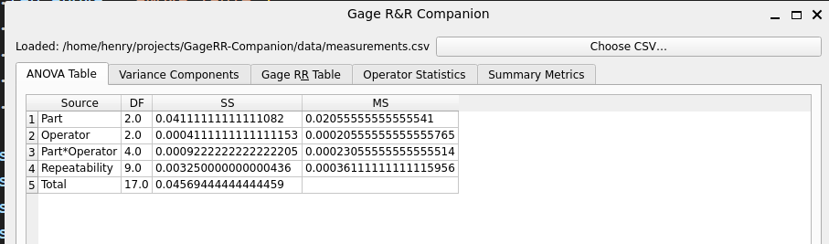
PyQt6 - Gage R&R Application
Incorporated Components:
File upload
Gage R&R analysis
ANOVA
Gage R&R Table
Variance breakdown
Repeatability
Reproducibility
Summary
GUI Output:
Lines of Code: 158

Slide 5

PyShiny
Pros:
Designed for data and statistics, easy to display tables and charts
Reactive design such that when an input changes only the affected outputs re-run and update
Web-based so no installation is needed
Cons:
Small community and is therefore hard to find help
Steep learning curve, have to understand reactivity
Framework is still maturing

Slide 6
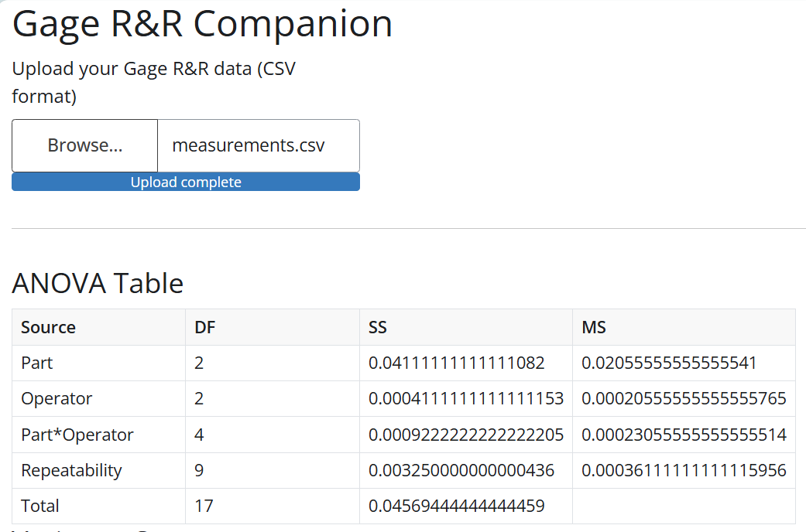
PyShiny - Gage R&R Application
Incorporated Components:
File upload
Gage R&R analysis
ANOVA (Pictured on right)
(Not pictured)
Gage R&R Table
Variance breakdown
Repeatability
Reproducibility
Summary
GUI Output:
Lines of Code: 91

Slide 7

StreamLit
Pros:
Minimal lines of code needed for tables, charts, etc.
Easy to integrate with existing code
Huge community with lots of answers on Stack Overflow
Web-based so no installation is needed
Lots of formal documentation with examples
Cons:
Runs whole script every time the input changes
Not built for multi-page complexity and has limited control over layouts

Slide 8
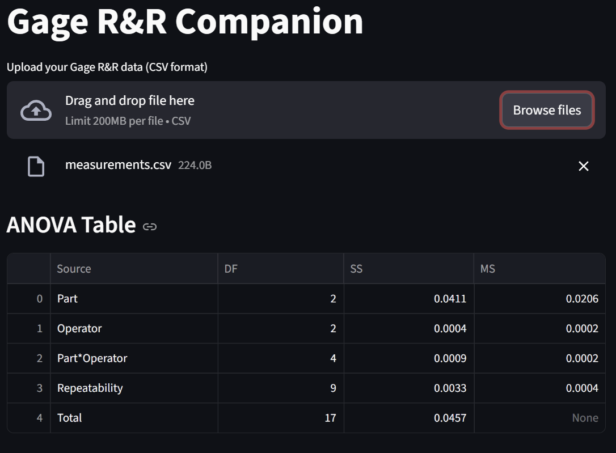
StreamLit - Gage R&R Application
Incorporated Components:
File upload
Gage R&R analysis
ANOVA (Pictured on right)
(Not pictured)
Gage R&R Table
Variance breakdown
Repeatability
Reproducibility
Summary
GUI Output:
Lines of Code: 23

Slide 9
Best Fit
We have decided to go with StreamLit for the following reasons:
There is minimal code and it is easy to learn
Built-in table and chart support is a natural fit for displaying tables and graphs include in Gage R&R results
Popular and very well documented online. Lots of references for LLMs to use when creating components
Priority for our tool is clear data display, ease of use, and fast results. StreamLit is built with that purpose in mind

